Slide 1


Who Wants to
Be a Millionaire?
Notes:
Lifeline icons on the question slides are hyperlinks which will take you to the lifeline screen. To return to the game, you may right click on the screen, choose Go, Previously Viewed. This should return you to the question slide. Alternatively, left click as usual to return to the game board, then click on the highest number that has been previously selected (in gold to indicate a followed hyperlink).
To utilize the 50:50 option, the moderator may tell the contestant which two options to disregard or, use Control-P to change the mouse arrow to a pen. Draw a line through two incorrect responses, then use Control-A to change the pen back into an arrow and continue with the game.
Clicking on the action button on the phone handset image of the Phone a Friend lifeline slide will hyperlink to the Ask Jeeves web site where the participant may ask for help.

Slide 2



1,000,000
500,000
250,000
125,000
64,000
32,000
16,000
8,000
4,000
2,000
1,000
500
300
200
100

Slide 3


Click to return to question, Cont-P to switch to the pen, cross out two incorrect answers, then Cont-A to switch back to pointer.

Slide 4

Click to return to the question and poll the class

Slide 5
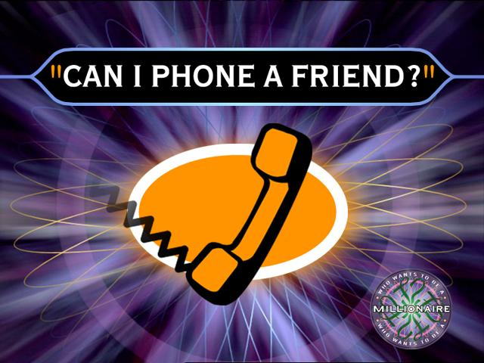
Click on link to Ask Jeeves, or click on this oval to return to question and ask a friend

Slide 6
Who is this?
A. Minnie Mouse
B. Mickey Mouse
C. Donald Duck
D. Daisy Duck

Slide 7
A . Minnie Mouse
Back to Board

Slide 8
What's mileys middle name?
A. Ruby
B. Grace
C. Hope
D. Cyrus

Slide 9
C. Hope
Back to Board

Slide 10
Who helped Cinderella go to the ball?
A. The Prince
B. Her fairy god
mother
C. The cat
D. Her step-mother

Slide 11
B. Her fairy godmother
Back to Board

Slide 12
What colour is mileys hair?
A. Brown
B. Grey
C. Cream
D. Blonde

Slide 13
A. Brown
Back to Board

Slide 14
Who is Poppie?
A. A shoe maker
B. a prince
C. a king
D. a sailor

Slide 15
D. A sailor
Back to Board

Slide 16
When's Mileys birthday?
A. 20th November
B. 16th September
C. 23rd November
D. 20th April

Slide 17
C. 23rd November
Back to Board

Slide 18
How old is Mickey Mouse?
A. 100
B. 80
C. 90
D. 50

Slide 19
B. 80
Back to Board

Slide 20
When was Miley born?
A.1892
B. 2000
C. 1992
D. 1919

Slide 21
C. 1992
Back to Board

Slide 22
Who made Mickey Mouse?
A. Play house Disney
B. Cartoon Network
C. Nicoloden
D. Walt diseny

Slide 23
D. Walt Diseny
Back to Board

Slide 24
What’s Mileys Brothers name?
A. Ben
B. Trace
C. Jack
D. David

Slide 25
B. Trace
Back to Board

Slide 26
Who is two of Mickey Mouse's friends?
A. Donald Duck and
Goffey
B. Minnie Mouse and
Daisy Duck
C. Miley and Hannah
Montana
D. Pluto and Pete

Slide 27
A. Donald Duck and Goffey
Back to Board

Slide 28
What’s Miley’s mom’s name?
A. Tish
B. Leticia
C. Sue
D. Poppy

Slide 29
B. Leticia
Back to Board

Slide 30
Who’s Tom and Jerry?
A. A shark and a fish
B. A rabbit and a pig
C.A cat and mouse.
D. A chicken and a dog

Slide 31
D. A cat and a dog.
Back to Board

Slide 32
What's Miley's favorite colour
A. purple
B. yellow
C. lime green
D. pink

Slide 33
A. purple

Slide 34
Sorry Try Again

Slide 35
Thanks for playing!

